Slide 1
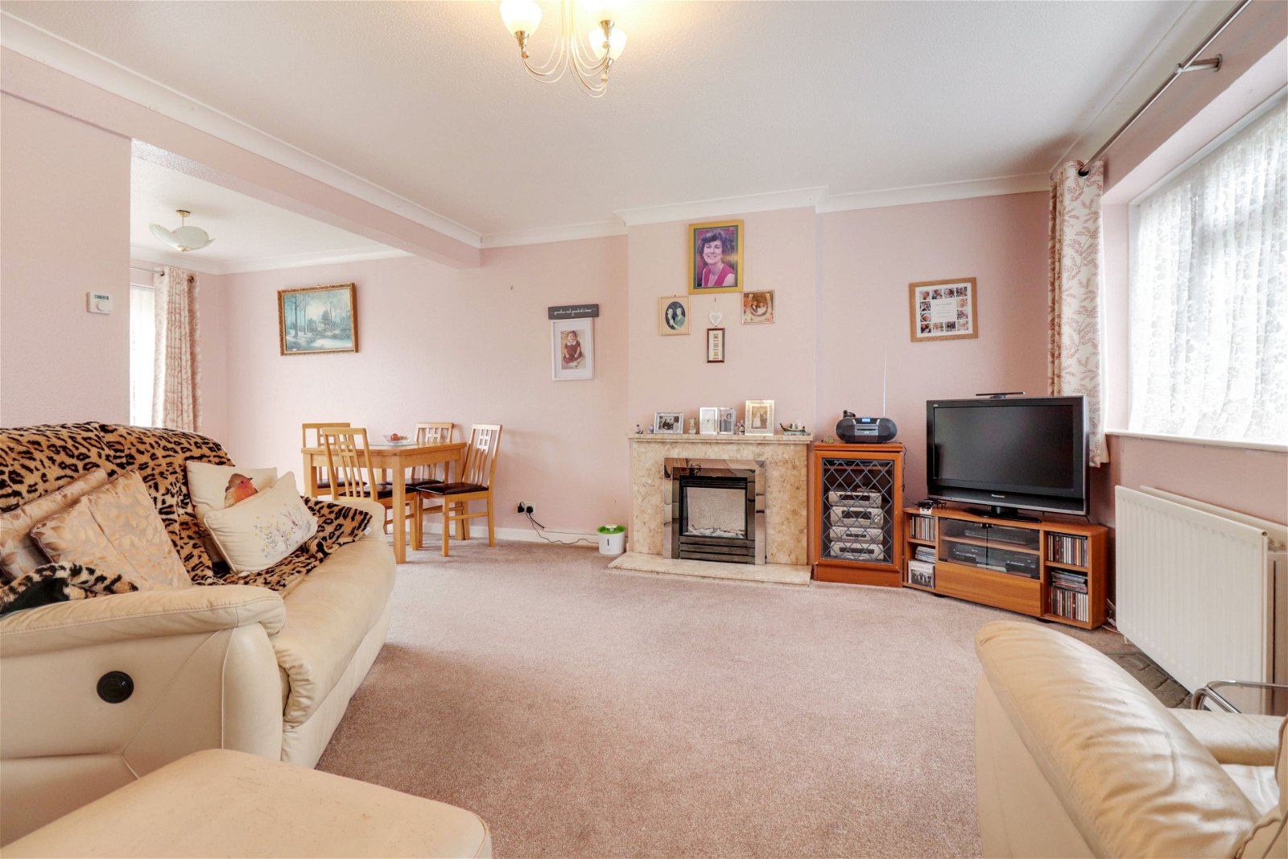
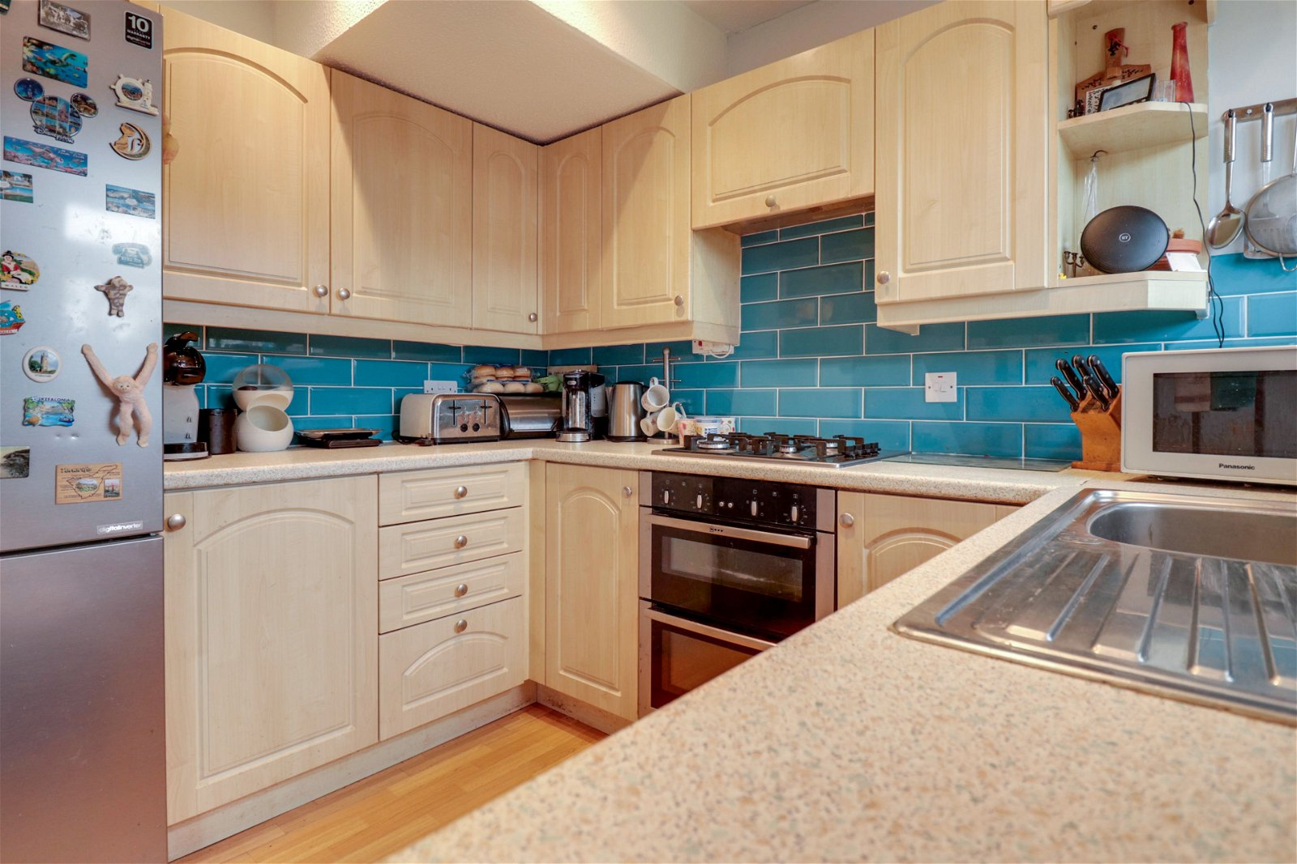
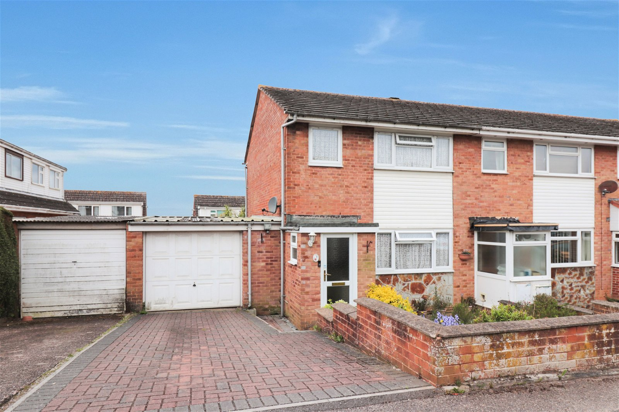
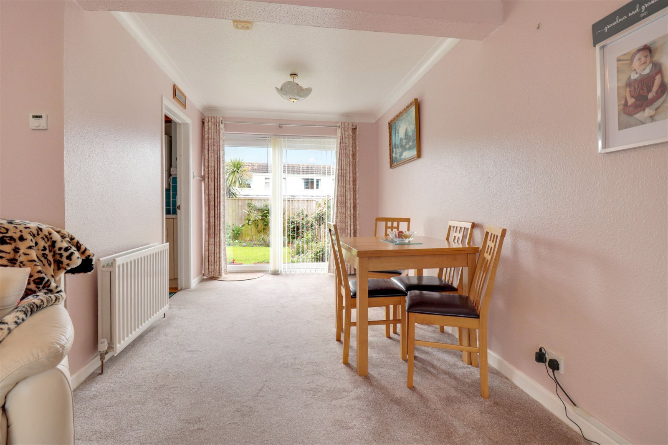
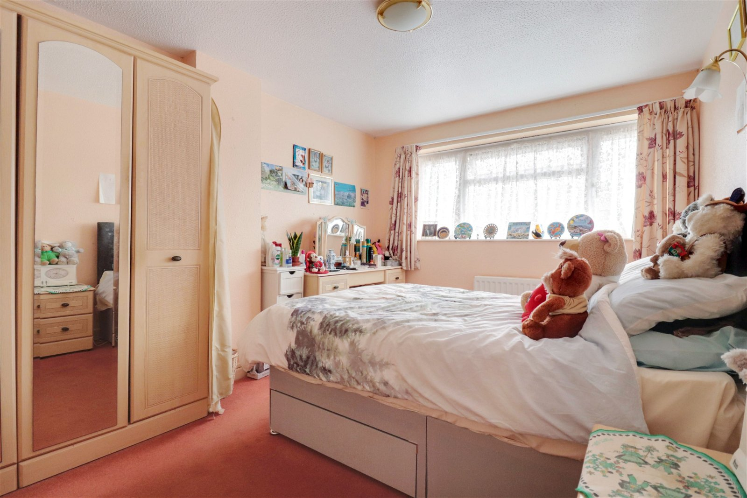
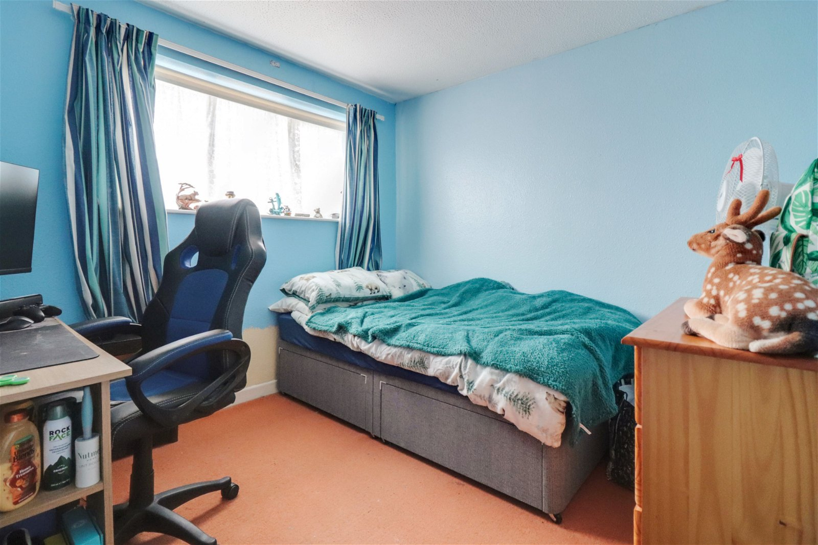
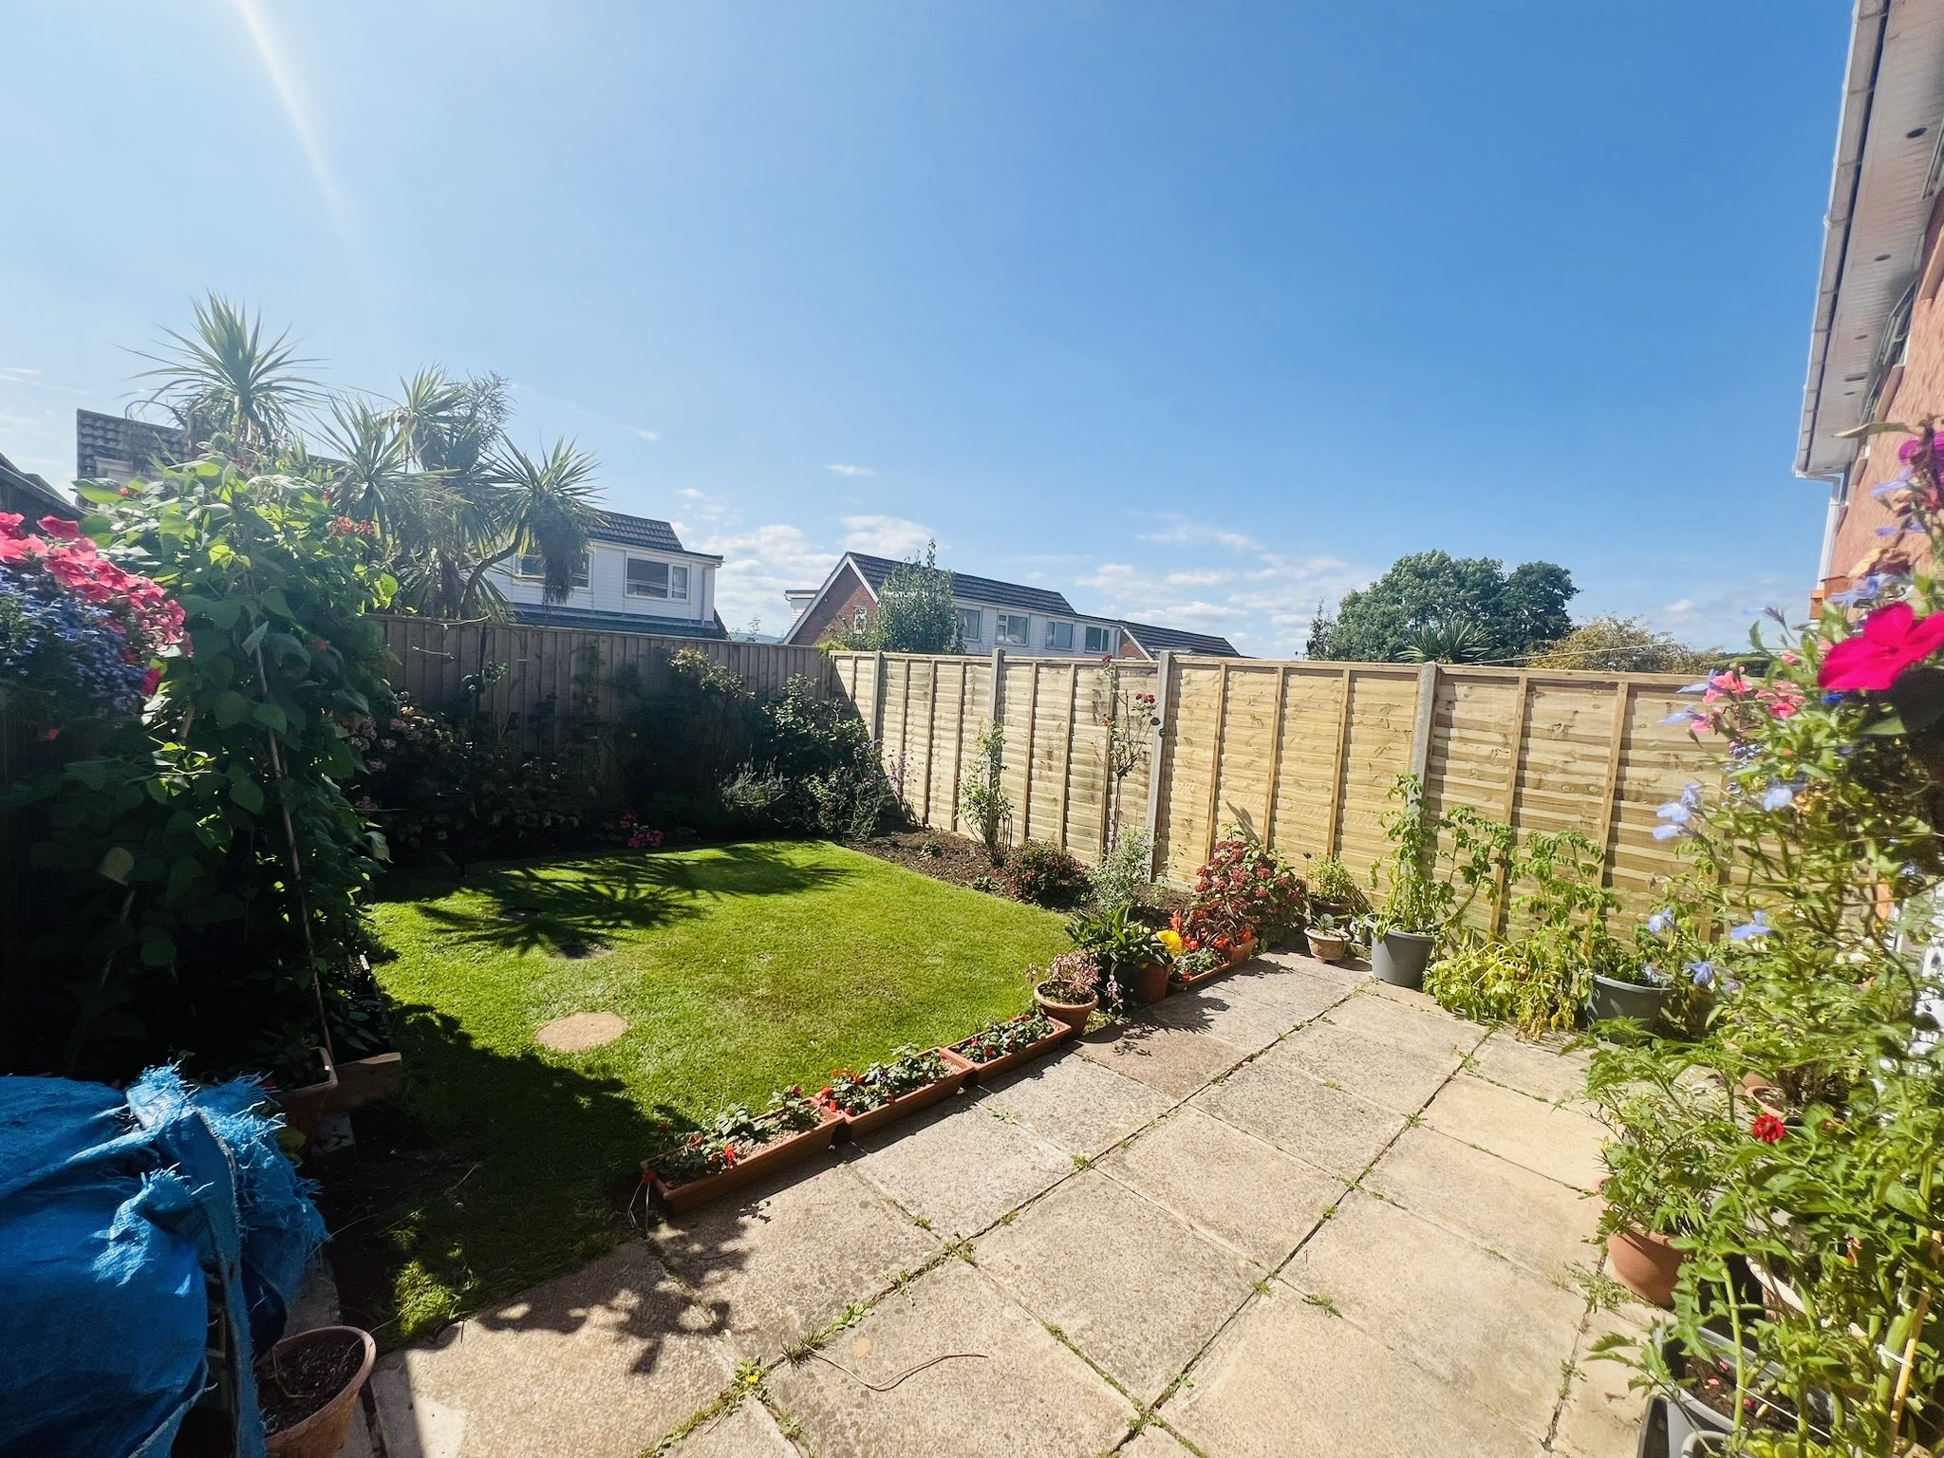
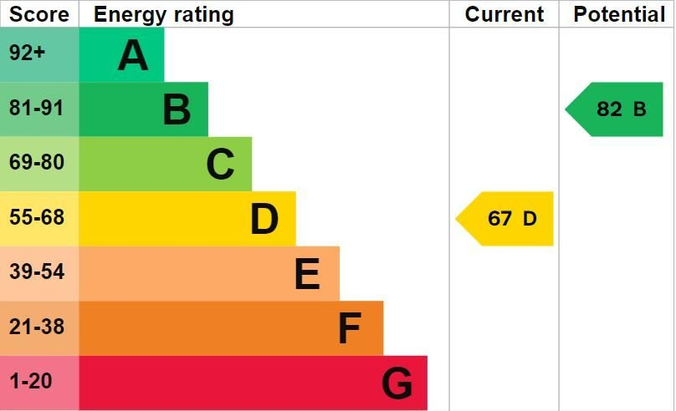
www.pennys.net
1 Poplar Close, Exmouth, EX8 5NX
GUIDE PRICE £280,000
TENURE Freehold
A Three Bedroom Family Home Located In A Popular And Convenient Location With Driveway, Good Size Garage And Southerly Aspect Rear Garden
Entrance Porch * Lounge/Dining Room * Kitchen * Three Bedrooms * Shower Room/Wc * Gas Central Heating * Double Glazed Windows * Super Family Home
Pennys Estate Agents Limited for themselves and for the vendor of this property whose agents they are give notice that:- (1) These particulars do not constitute any part of an offer or a contract. (2) All statements contained in these particulars are made without responsibility on the part of Pennys Estate Agents Limited. (3) None of the statements contained in these particulars are to be relied upon as a statement or representation of fact. (4) Any intending purchaser must satisfy himself/herself by inspection or otherwise as to the correctness of each of the statements contained in these particulars. (5) The vendor does not make or give and neither do Pennys Estate Agents Limited nor any person in their employment has any authority to make or give any representation or warranty whatever in relation to this property.
PENNYS ESTATE AGENTS
2 Rolle House, Rolle Street, Exmouth, Devon, EX8 2SN
Tel: 01395 264111 EMail: help@pennys.net

Slide 2
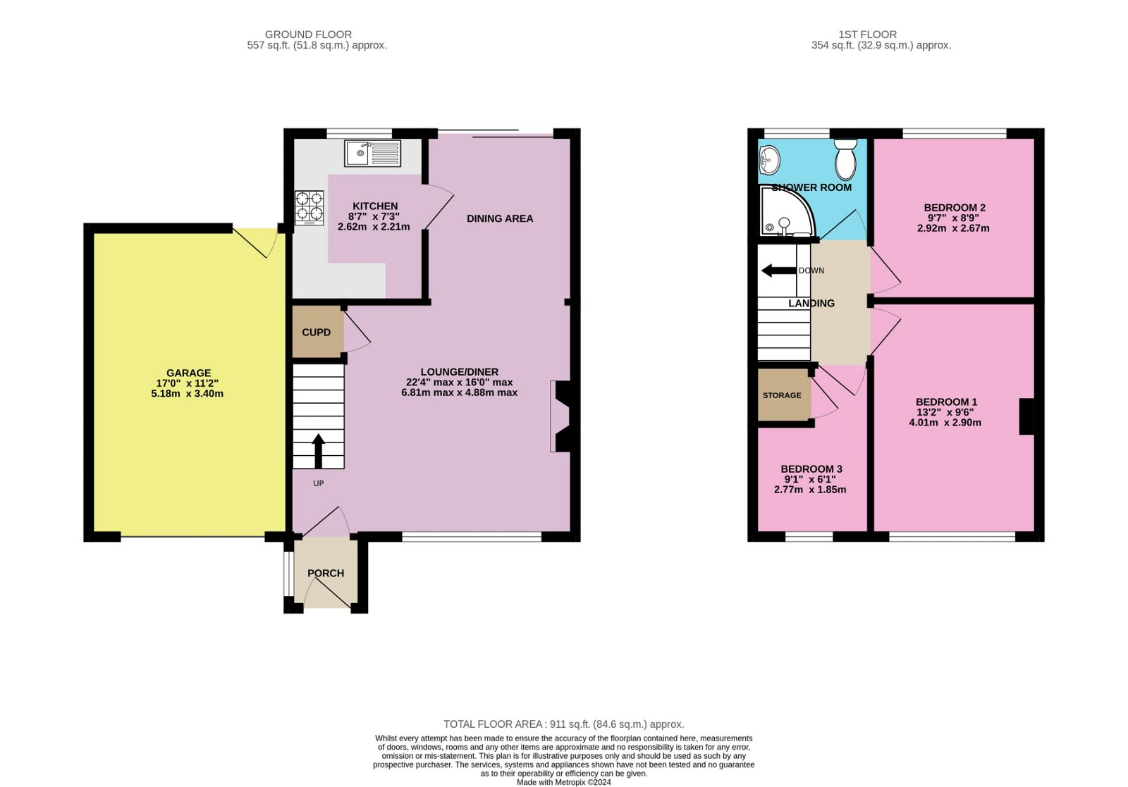
1 Poplar Close, Exmouth, EX8 5NX
THE ACCOMMODATION COMPRISES: Double glazed front door giving access to:
ENTRANCE PORCH: Double glazed windows, inner door to:
LOUNGE/DINING ROOM: 6.91m x 4.85m (22'8" x 15'11") narrowing to 2.49m (8'2") Spacious room with marble fire surround housing living flame electric fire, TV point, two radiators, double glazed window to front aspect and sliding double glazed patio doors opening onto the rear garden. Stairs rising to first floor landing with useful stairs storage cupboard beneath.
KITCHEN: 2.67m x 2.13m (8'9" x 7'0") With patterned worktops with tiled surrounds, cupboards and drawer units and integrated dishwasher beneath. Sink unit set into work surface, gas hob with built-in oven below and extractor hood over, range of wall mounted cupboards, space for upright fridge/freezer, wall mounted gas boiler for hot water and central heating, recessed ceiling spotlighting, double glazed window to rear aspect.
FIRST FLOOR LANDING: With access to the roof space.
BEDROOM 1: 4.09m x 3m (13'5" x 9'10") With double glazed window to front elevation, radiator.
BEDROOM 2: 2.95m x 2.74m (9'8" x 9'0") With double glazed window to rear elevation.
BEDROOM 3: 2.87m x 1.88m (9'5" x 6'2") Double glazed window to front elevation, radiator, fitted linen cupboard over stairwell recess.
SHOWER ROOM/WC: 2.01m x 1.83m (6'7" x 6'0") With shower cubicle with shower splashback walls, pedestal wash hand basin, WC, tiled walls, medicine cabinet, chrome heated towel rail. Double glazed window with patterned glass.
OUTSIDE: The property benefits from a block paved driveway leading to the larger than average GARAGE alongside the property. Attractive front garden with colourful flower and shrub beds. To the rear is a sunny Southerly aspect garden laid to lawn edged with flowerbeds and borders. Patio area for outside entertaining.
GARAGE: 5.33m x 3.45m (17'6" x 11'4") Up and over door, power and light connected. Plumbing for automatic washing machine.
FLOOR PLAN:

